Slide 1
DevOps Engineering - Planning to Production
Pranjal Srivastava

Slide 2
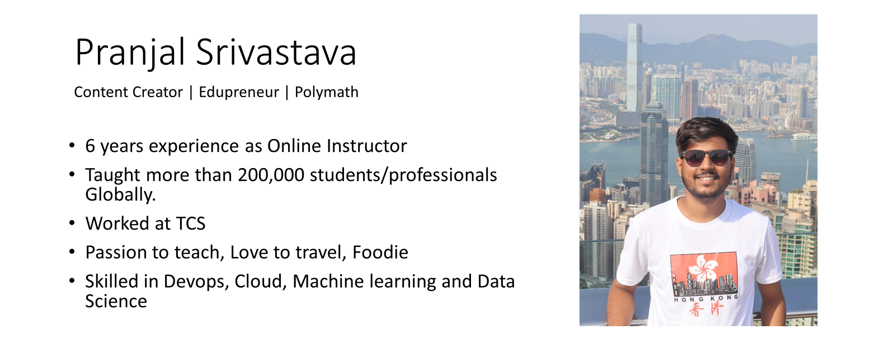
https://www.linkedin.com/in/srivastavapranjal/
https://github.com/iampsrv

Slide 3
Agenda
Course Overview
Preliminary Knowledge
Tools Required
Projects

Slide 4
Preliminary Knowledge
Operating Systems
Linux basics (commands, permissions, shell scripting)
Networking fundamentals (IP, DNS, HTTP, ports, firewalls)
Version Control Systems
Git basics (clone, commit, branch, merge, rebase, pull requests)
Basic Programming/Scripting
Bash scripting
One high-level language (Python, Go, or JavaScript)
Databases
SQL basics
Understanding of database backups and migrations

Slide 5
Core DevOps Tools & Categories
Version Control: Git, GitHub, GitLab, Bitbucket
CI/CD: Jenkins, GitLab CI, GitHub Actions, CircleCI
Configuration Management: Ansible, Puppet, Chef
Containerization: Docker, Podman
Container Orchestration: Kubernetes
Cloud Platforms: AWS, Azure, GCP (start with one)
Monitoring & Logging: Prometheus, Grafana, ELK Stack, Splunk
IaC (Infrastructure as Code): Terraform, AWS CloudFormation

Slide 6
Tools Required
Visual Studio code or any IDE
Docker Desktop
Minikube
AWS
Git
Github
Ansible
Terraform
Jenkins
Prometheus
Grafana

Slide 7
Mindset for Success in DevOps
Automation First: If you have to do something twice, script it.
Fail Fast, Recover Faster: Build reliable rollback and recovery processes.
Measure Everything: Metrics drive improvement.
Continuous Learning: Tools evolve, but principles remain

